Slide 1

AMAZON SALES ANALYSIS

Slide 2
INTRODUCTION
Effective sales management is vital in today's competitive landscape.
This project tackles sales trend analysis on an Amazon dataset.
In this my role is to process sales data to uncover trend to gain valuable insights for strategic decision-making.

Slide 3



DETAILS OF DATA
Sum of the units sold 5,12,871
Sum of total profit 44,168,198.40
Sum of total revenue 137,348,768.31
Sum of total cost 93,180,569.91

Slide 4

MAIN KPI ‘s
UNIT PRICE - THE PRICE AT WHICH WE SELL ONE UNIT OF PRODUCT OR SERVICE FOR.
UNITS SOLD– THE NUMBER OF UNITS OF A PRODUCT OR SERVICE WE SELL.
UNIT COST– THE COST TO PRODUCE ,STORE,AND SELL ONE UNIT OF A PRODUCT OR SERVICE
TOTAL REVENUE– THE TOTAL AMOUNT OF MONEY WE EARN BY SELLING THE PRODUCTS
TOTAL COST – THE TOTAL AMOUNT OF MONEY SPENDED TO PRODUCE AND SELL THE PRODUCT
TOTAL PROFIT – MONEY REMAINING AFTER SUBTRACTING TOTAL COST FROM TOTAL REVENUE.

Slide 5
MOCK – UP DASHBOARD
The main goal is to gather constructive feedback to improve the final product
Sum of total cost
93,180,569.91
Sum of the units sold 5,12,871
Sum of total profit 44,168,198.40
Sum of total revenue 137,348,768.31
MONTHLY RANGE
COUNT OF ATTRITION
AGE RANGE
ATTRIBUTION BY
AGE
ATTRITION By Martial Status

Slide 6
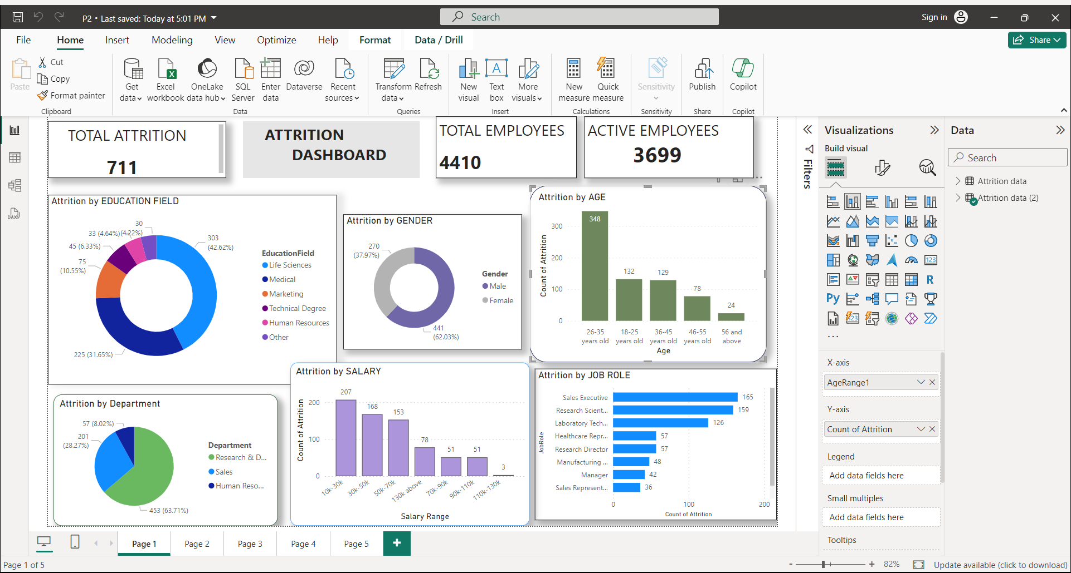
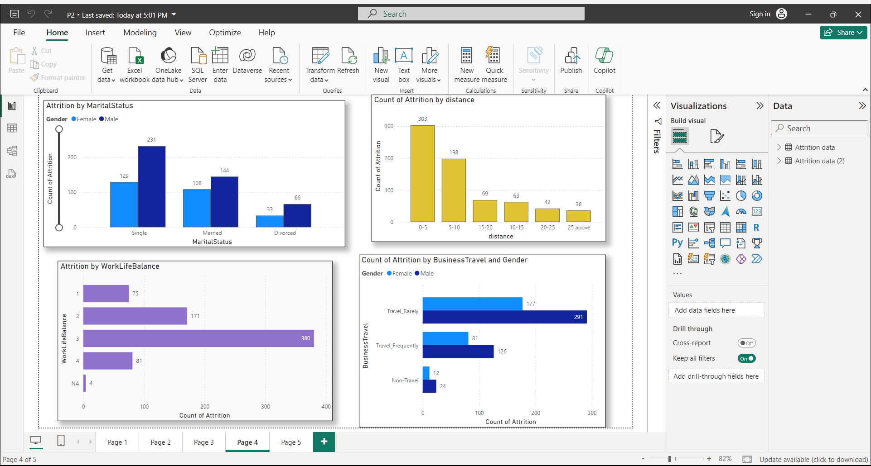
MY DESIGN

Slide 7
Thank you!

